Slide 1

Legal Document
Summarization and QA System

Slide 2


The Legal Context Problem
Legal documents pose significant accessibility barriers:
Extensive Length: Often spanning 10 to over 100 pages per case.
Dense Legalese: Complex terminology and archaic syntax structures.
Information Sifting: Critical facts are buried deep within textual noise.
Objective: A system that provides concise summaries and grounded answers to natural language questions.

Slide 3
Proposed System Architecture
A three-tier pipeline designed for modular efficiency:
Preprocessing: Text extraction and structure detection.
Summarization: Two-stage (Extractive + Neural) module.
QA Module: Retrieval-based extractive answering.

Slide 4
Module 1: Document Preprocessing
Text Extraction & Cleaning: Robust PDF parsing followed by removal of headers, footers, and redundant case citations.
Structure Exploitation: Pattern-based detection of standard legal sections: FACTS, ARGUMENTS, JUDGMENT, ORDER.
Why this matters: Legal documents follow a predictable semantic structure; exploiting it reduces noise and improves context.

Slide 5


Module 2: Summarization Module Overview
Two Paths
Extractive Baseline
Neural Abstractive
Uses TextRank algorithm. Sentences are nodes in a similarity graph. Top-ranked nodes form the summary. Stable and interpretable.
A BiLSTM + Attention model. Trained to generate novel sentences by understanding the latent semantics of the context.

Slide 6
Extractive Baseline: TextRank
Vectorization
Similarity
PageRank
Selection
Sentences are represented using TF-IDF vectors.
Build an Adjacency Matrix using Cosine Similarity.
Apply graph-based ranking to identify core nodes.
Extract top-k sentences based on centrality.

Slide 7
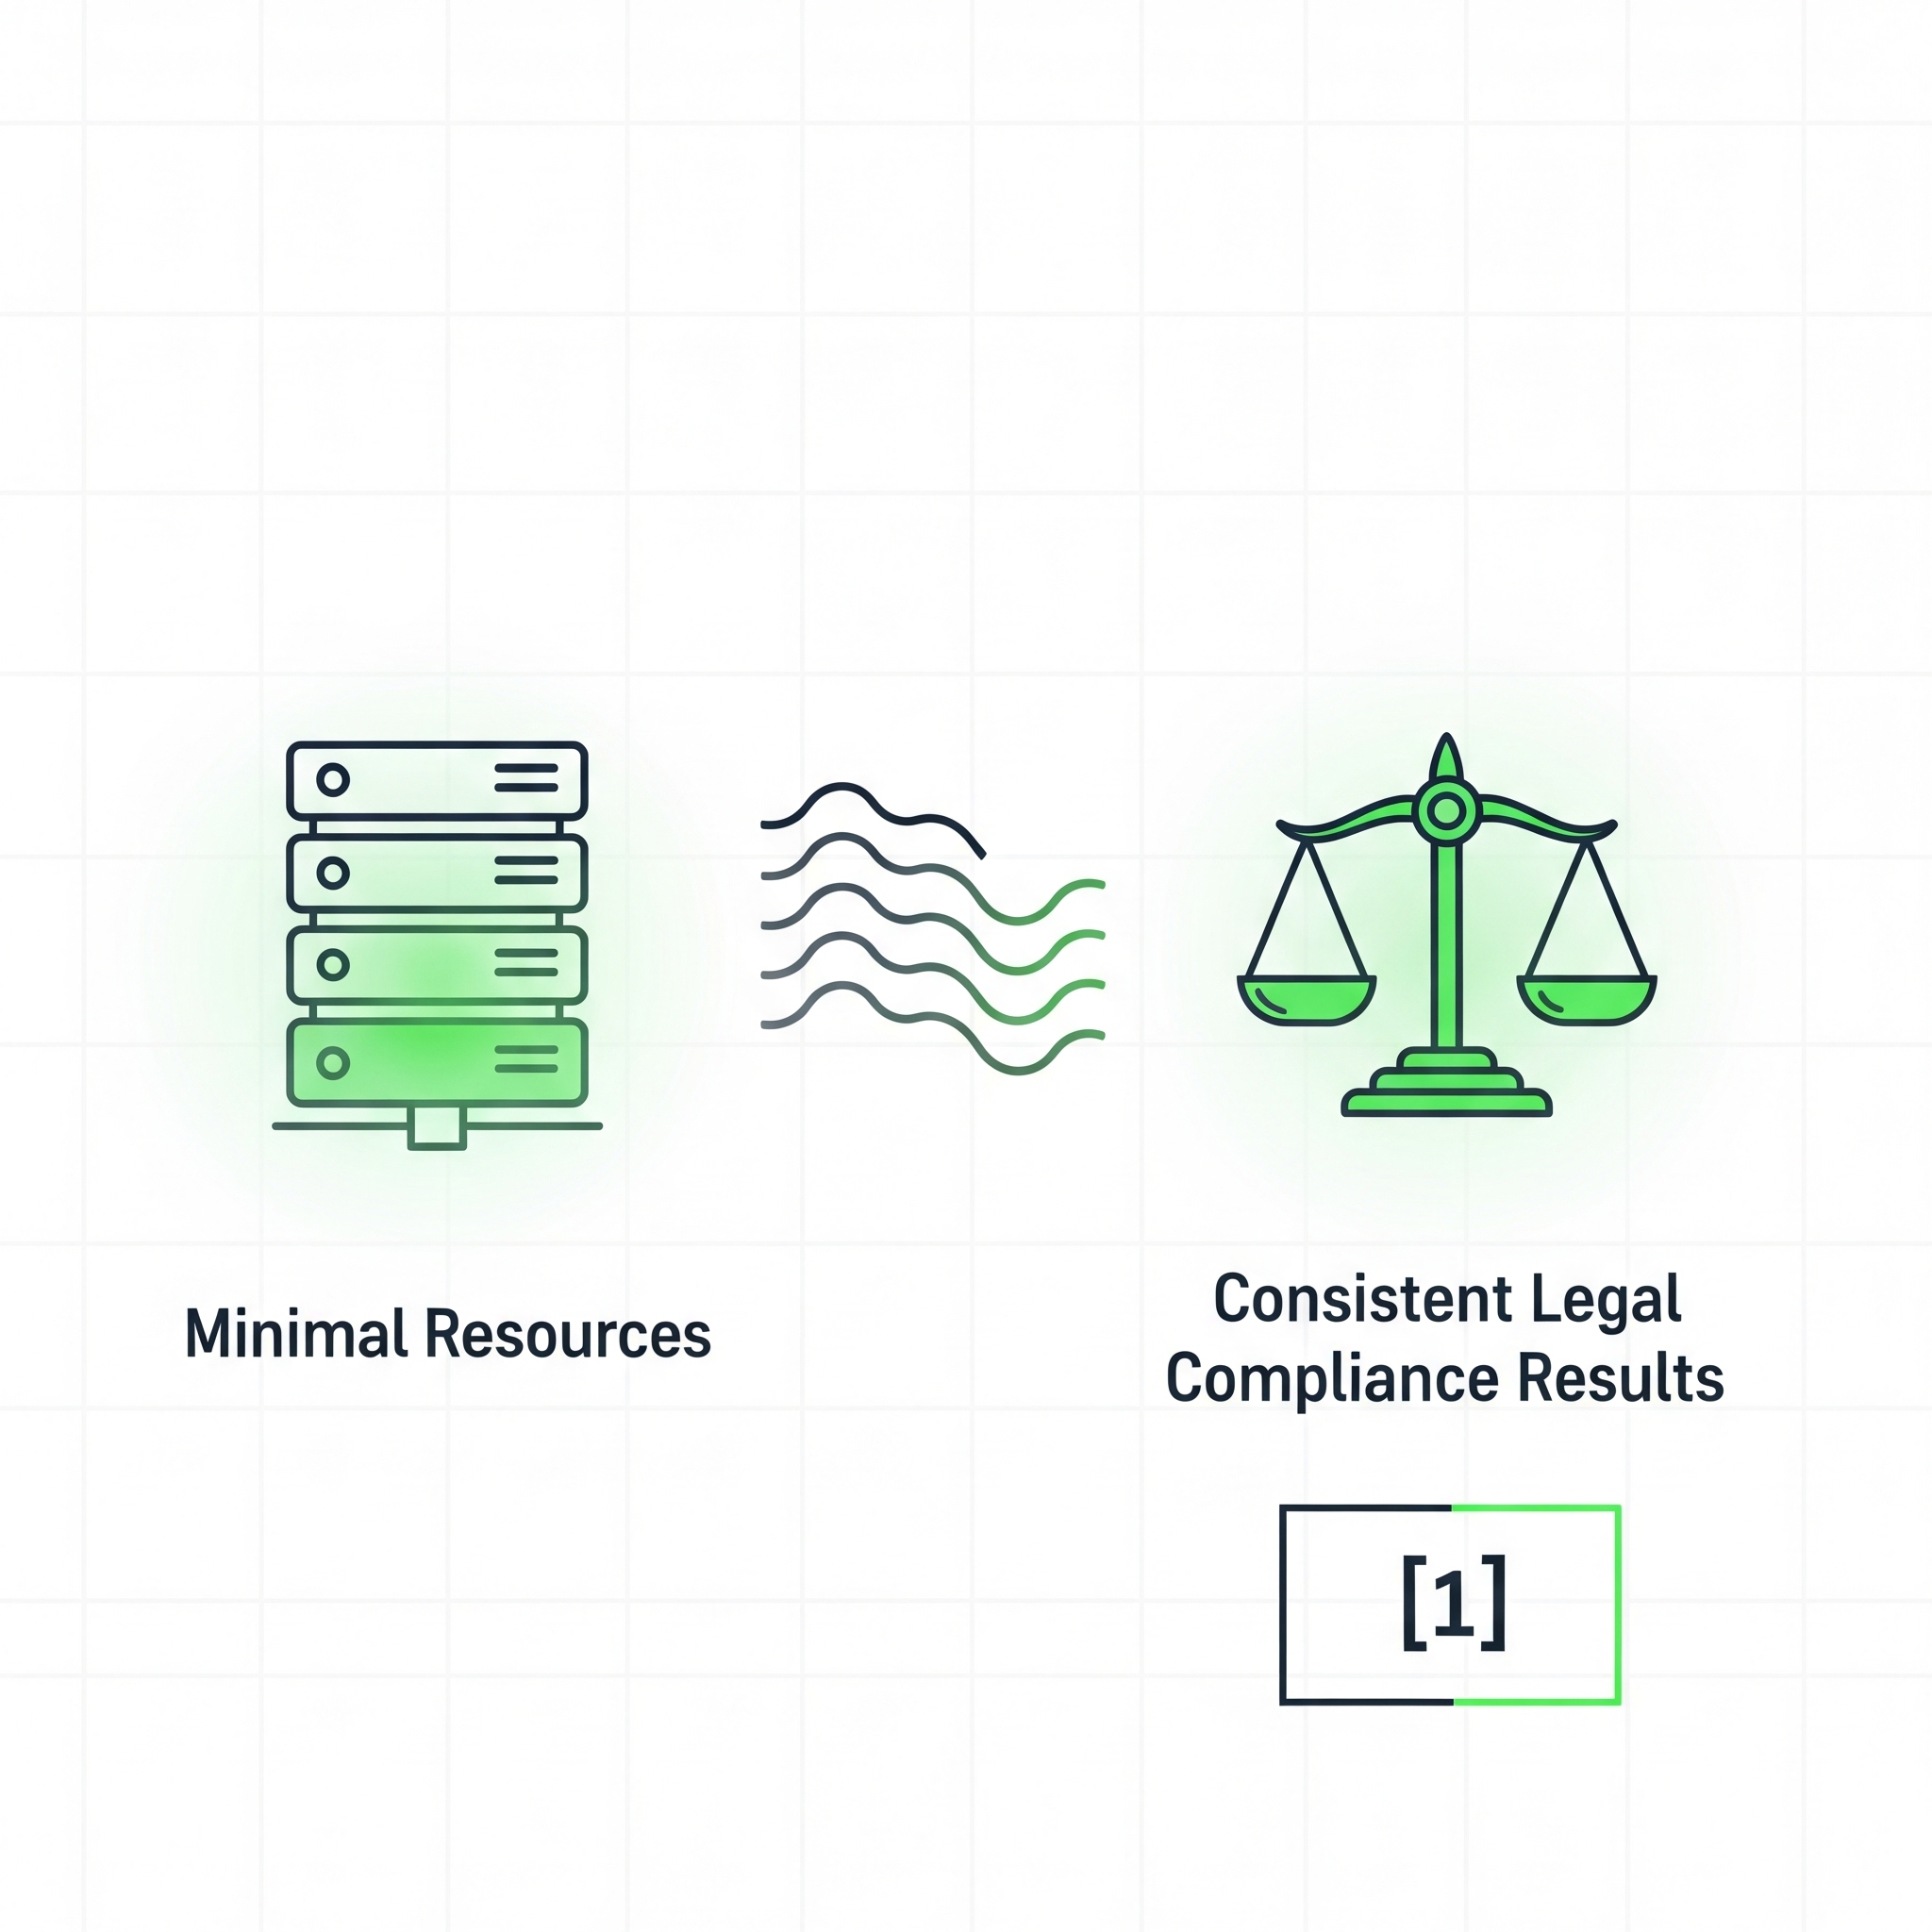
Why TextRank ?
Requires minimal computational resources compared to neural models.
No training data needed, works on any legal document immediately.
Provides a solid reference point for measuring neural model improvement.

Slide 8
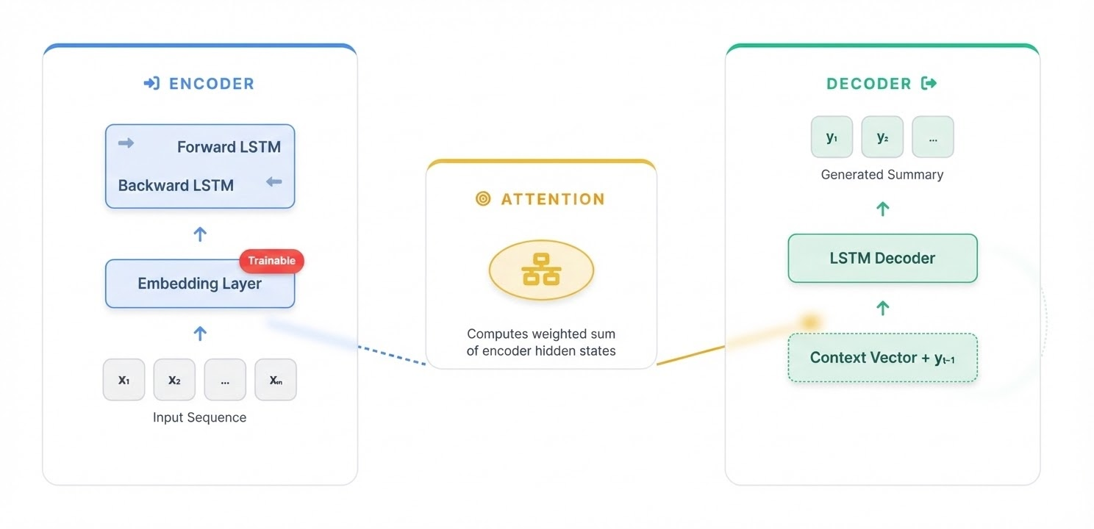
Neural Abstractive Model
BiLSTM + Attention
Embedding : Embedding layer trained from scratch on legal corpus
Encoder: Bidirectional LSTM captures long-term dependencies in both directions.
Attention: Mechanism calculates weights over encoder states to focus on relevant context.
Decoder: Generates summary token-by-token from a scratch-trained embedding space.

Slide 9
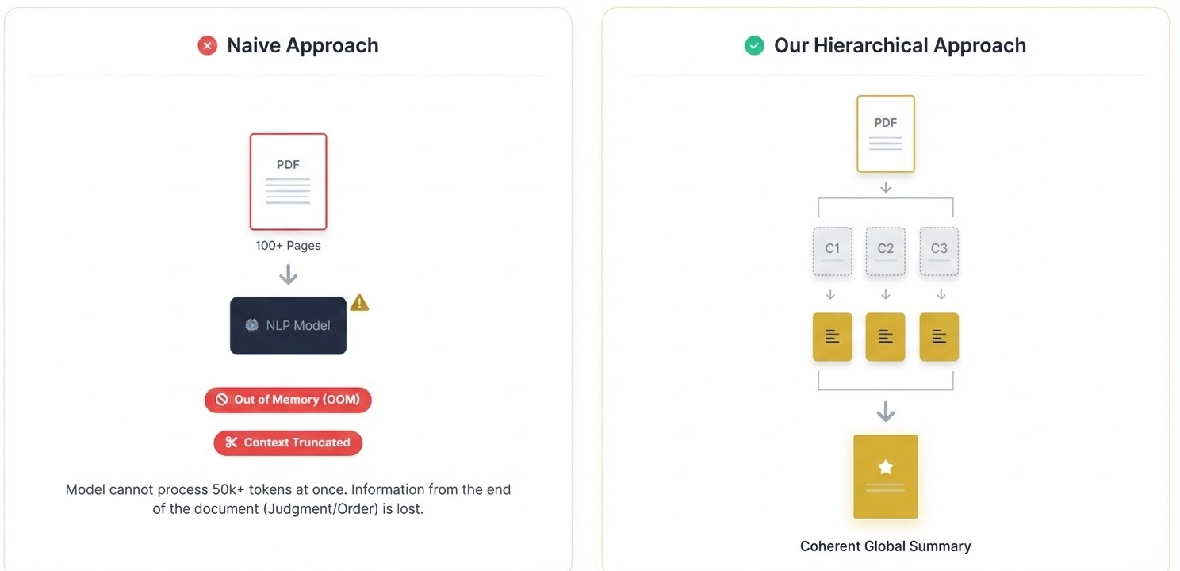
Plain English Conversion
A sequence to sequence model that translates legal language into simple, user friendly English

Slide 10


Module 3: The Question Answering Module
Stage 1: Retrieval
Stage 2: Prediction
Encodes both the user's question and document chunks into vector embeddings and computes similarity scores to retrieve the top-k most relevant chunks. These candidate chunks are then passed to the answer prediction model.
For answer prediction we will either use a BiLSTM with attention to model the interactions between the question and retrieved chunks or we will use a lightweight Transformer encoder to encode the question and chunks and predict the start and end positions of the answer span in the text.
Previous question and answer pairs stored in a history buffer after each turn. Last 2-3 QA pairs appended to the current question before retrieval. Allows follow-up questions like "what about the penalty for that?" to work correctly without re-explaining context. No extra model needed — just a growing list maintained across the session.
Stage 3: Answer Generation
Stage 4: Conversation Memory
A BiLSTM encoder–decoder with attention produces natural responses from the extracted evidence, while a pointer mechanism copies critical legal terms directly from the document to preserve precision.

Slide 11


Retrieval Module: TF-IDF & Cosine
To avoid processing 100 pages for every question, we use a lightweight retrieval mechanism:
Interpretable: No "black-box" vector embeddings.
Fast: Low latency even with thousands of document chunks.
Grounded: Forces the model to only look at text present in the document.

Slide 12
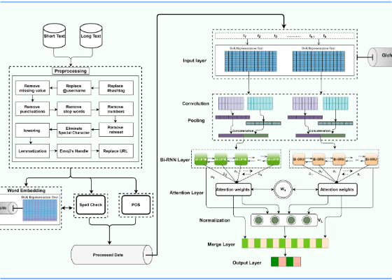
Extractive QA Model Design
Input Encoding: Concatenation of [Question] and [Context] tokens into a joint BiLSTM encoder.
Span Prediction: Two output layers calculate probabilities for each token being the Start or End of the answer.
Zero Hallucination: By design, the model cannot invent facts; it can only select existing text.
Efficiency: Lightweight architecture suitable for deployment on standard CPU servers.

Slide 13
Evaluation Strategy and Metrics
Module | Primary Metric | Secondary Metric | Goal
Summarization | ROUGE-1 / ROUGE-L | Compression Ratio | Informational overlap and brevity.
Retrieval | Precision @ K | MRR | Ensuring answer context is retrieved.
Extractive QA | Exact Match (EM) | F1-Score | Precision of span boundary prediction.

Slide 14


Challenges and Risk Mitigation
Challenge: Training Instability (BiLSTM)
Challenge: Long-Range Dependency Limitations
Deep BiLSTMs can suffer from vanishing or exploding gradients when trained on long legal sequences.
Legal documents contain cross-references across distant clauses, which BiLSTMs may struggle to model effectively.
Mitigation: Gradient clipping, layer normalization, residual connections, and careful learning rate scheduling.
Mitigation: Attention mechanisms and overlapping chunking to preserve contextual continuity.
Challenge: Quadratic Memory Complexity (Transformer)
Self-attention scales quadratically with sequence length, increasing memory and computation cost for long legal texts.
Mitigation: Chunk-based processing (800–1200 tokens), small model configuration, and hierarchical summarization.

Slide 15
Datasets Used
1️⃣ CUAD (Contract Understanding Atticus Dataset)
🔗 https://huggingface.co/datasets/theatticusproject/cuad
Used to train:
Extractive QA model (question → answer span)
Simplification model (legal sentence → plain English, synthetic pairs)
2️⃣ MultiLexSum
🔗 https://huggingface.co/datasets/allenai/multi_lexsum
Used to train:
Abstractive summarization model (legal document → summary)
3️⃣ BillSum
🔗 https://huggingface.co/datasets/FiscalNote/billsum
Used to train:
Additional long-document summarization

